Slide 1
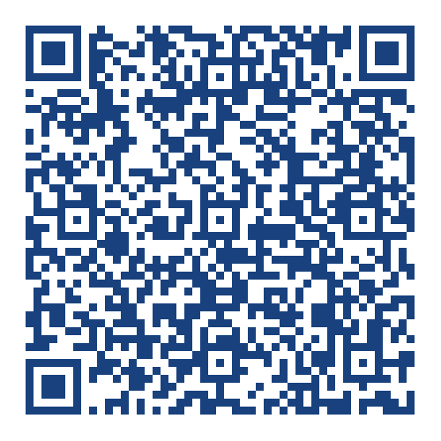
Generating User Requirements
Dr. Michael Robbeloth
Teaching Demonstration
Target Course: CSE 3231 (Software Engineering Techniques)
March 18, 2025
Notes:
QR code if you want to download the presentation
Not enough time here to go into system requirements.

Slide 2
Agenda
Teaching Demo: Generating User Requirements

Slide 3

Course and Learning Objectives Targeted
From master syllabus:
Be competent with structured and agile software engineering frameworks; specifically structured and agile software engineering methodologies for requirements identification, analysis, architecture, design, testing, deployment and project management
Notes:
https://syllabi.engineering.osu.edu/syllabi/cse_3231

Slide 4
Topic & ABET Coverage
From master syllabus:
Requirements gathering. Structured and agile requirements work-products (4.0 lecture hours)
ABET-CAC Criterion 3 Outcomes: 1, 3, 5, and 6
ABET-EAC Criterion 3 Outcomes: 1, 3, 5, and 7
Notes:
CAC: 1. Analyze a complex computing problem and to apply principles of computing and other relevant disciplines to identify solutions.
3 Communicate effectively in a variety of professional contexts.
5 Function effectively as a member or leader of a team engaged in activities appropriate to the program’s discipline
6. Apply computer science theory and software development fundamentals to produce computing-based solutions.
EAC
an ability to identify, formulate, and solve complex engineering problems by applying principles of engineering, science, and mathematics
3. an ability to communicate effectively with a range of audiences - pre-2019 EAC SLO (g)
Function effectively as a member or leader of a team engaged in activities appropriate to the program’s discipline
7. an ability to acquire and apply new knowledge as needed, using appropriate learning strategies

Slide 5
After defining the problem to solve…
Assuming we are solving the correct problem 🤔
Goal should be to use digital technology to solve the problem creatively
Think more about searching an opportunity space
Notes:
Or a market segment in need of disruption
Not just a problem space

Slide 6
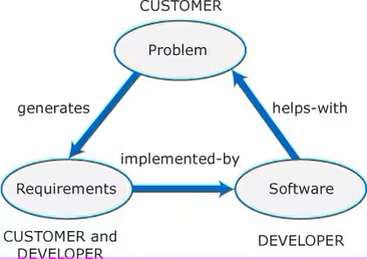
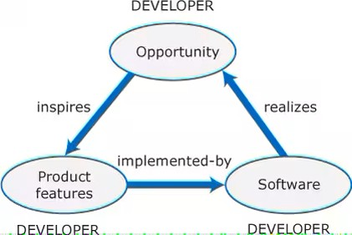
What features will the solution contain?
A digital technology platform is composed of some software components
Each component will have some features that are critical to solving the problem
The features originate from the user (custom software or project-driven development) or the team (market-driven or product development)
The goal should be to create a new digital workflow, replace inefficient processes, or shake up/disrupt a market segment
Notes:
What could those components be? Frontend, backend, middleware, microservices, embedded device, edge device, etc.
Features may also be conditions or capabilities needed in the MVP
Items that may be required in a contract
Software products don’t have a customer, there might be a marketing team/sales team working with an engineering team, maybe not. It could be a startup.
Product software is often cheaper, but the customer has to adopt their workflows to the product.

Slide 7
Why bother with requirements? 1/2
Help us to clearly understand what we want the software to do
Provide a roadmap 🗺️ to implementation, guide short development cycles (aka sprints in agile)
Everyone is on the same page – no misunderstandings
Provide a basis for testing and validation (building the right software)
Notes:
Do you know what stakeholders are? Parties w/ a vested interest in the success of the project. No misunderstandings, no surprises.
Vs. verification building the software right – we want to find issues as early as possible, cheaper to fix

Slide 8
Why bother with requirements? 2/2
Keep costs down (more 💵💶💷 for you)
Reduce risk!
Keep the client or customer satisfied
Document the project (provide traceability)
Source of future feature requests when prioritizing
Notes:
Part of keeping costs down is that by having requirements in writing, a project manager better understands how to allocate resources to the project
Eliminate the known unknowns at least, can’t do as much about the unknown unknowns until planning the next sprint
Get feedback early and often is important. Agile prefers to have an embedded client/sponsor w/ team for most timely feedback, but not practical in my experience.
Keep in mind for product driven development that

Slide 9
What is a User Requirement
A natural language statement from the user’s perspective of what the system should do
It may be something the user doesn’t want the system to do.
User in project development: client and/or user (keep in mind who writes the check)
User in product development: customer
Notes:
Keep in mind requirement engineering for project development could get quite complex if it involves contracts.
I realize we should probably be engaged in a wider discussion on stakeholders here, but this covers the core parties.

Slide 10
Types
Functional
Non-functional
Domain

Slide 11
Functional Requirements
What the software (or the respective component) should do
An action to be performed in the system
Something the user should be able to do w/ the software
Notes:
… in solving some aspect of the problem that the user is facing that necessitated the need for this software to be built
Performing a calculation, modifying data in some way or through some process, providing some mechanism for the user to interact with the software
The user can identify this requirement as some manifestation in the system

Slide 12
Non-Functional Requirements
How the software should perform a given task
Metrics (examples)
Performance
Usability
Reliability
Security
Usually a constraint of some type
Notes:
system’s behavior, quality, and constraints
Most likely where your development team will speak up on tooling/programming language/tech stack choices
Imprecision is likely to occur here w/ goals. When possible, use metrics that can be verified with testing activities.

Slide 13
Domain Requirements
Subject-matter expert (SME) style of requirements
We are generalists, we are not usually experts in another field
Pertain to some domain/industry where the software will be used
Notes:
FERPA in education or Sarbanes-Oxley in financial applications
Here you depend on the user to give you important background information to surface these requirement
May require you to spend an extended amount of time researching the field, interviewing others at the client’s site, or hiring an expert if developing the software for some target market w/o a sponsoring client

Slide 14

How to gather user requirements? 1/3
Interviews
Surveys
Focus Groups
Observations
Notes:
Ask students this question, try to guide them toward desired responses
Requirements elication and analysis according to Sommerville.
Interview (Previous institution: I have students do two rounds of interviews, generating user/system requirements, have client sign off). If it was product-centric dev., I would sign off. Students learn to be mindful of customers who don’t know what they want or express requirements in their language, clarification is needed. Guide the interview. How many stakeholders? Politics?
Surveys (need critical mass here)
Focus Groups (extra preplanning, but efficient to conduct)
Observation (expensive, time consuming for team to build scripts, record video/notes, process video, do follow-up, but provides lots of actionable information)
Use Case Analysis:
Pros: Provides detailed scenarios of how users interact with the product, helping to identify specific requirements.
Cons: Can be time-consuming and may miss broader user needs not covered by the use cases.
Comparison: Use case analysis focuses on specific interactions, while the Kano method provides a broader view of user satisfaction across various features.
Brainstorming Sessions:
Pros: Encourages creative thinking and collaboration among stakeholders.
Cons: May result in a lot of ideas without a clear way to prioritize them.
Comparison: Brainstorming generates ideas, and the Kano method can help prioritize those ideas based on user satisfaction.

Slide 15
How to gather user requirements? 2/3
Can you think of some other approaches?
Prototyping (maybe w/ focused observations)
Case studies
Brainstorming sessions

Slide 16

Properties of Requirements
Complete (provided everything needed in an MVP)
Consistent (don’t conflict w/ one another)
Notes:
Now, feedback from the user in an agile system should be helpful in updating requirements prior to a new sprint
Extreme teams would have the user embedded
Practically speaking, send the deliverable to the user at the end of the sprint, hopefully get feedback in time for the next one to start. If not, punt feedback into n+2 sprint.

Slide 17
How to gather user requirements? 3/3
Use MoSCoW method
Use Kano method
Notes:
I don’t recall Sommerville ever having any methodology for organizing requirements. Again, I tend to like the MoSCoW method since I used it in industry and had students in my practicum courses use it.
Sommerville would just put everything into a requirements document organized by category based on the context of the project.

Slide 18
MoSCoW Method
Must Haves
Should Haves
Could haves
Won’t haves
Notes:
Perform an exercise using MoSCoW method

Slide 19

Student Participation Time ☺
What are some user requirements we might have in a command-line slide extractor program? (MoSCow method)
We’ll consider this product-focused development ☺?
We’ll sell our product into the Microsoft app store 🤣or on our website.
Notes:
Show your silly slide extractor project

Slide 20

Must Have
Command-line Input: The program must accept command-line arguments, specifying the PowerPoint file path and the desired slides to extract.
Slide Extraction: Must extract specific slides from a PowerPoint presentation based on user input.
Export Format: Must save the extracted slides in a commonly used format (e.g., PNG, JPEG, GIF, or PDF?).
Error Handling: Provide meaningful error messages for missing files, incorrect input formats, or unsupported file types.
Basic Documentation: Include a README explaining how to compile and use the program.

Slide 21
Should Have
1. Batch Processing: Should support processing multiple presentations in one run.
01
Custom Output Directory: Allow users to specify an output directory for extracted slides.
02
Supported Formats: Should handle both .ppt and .pptx formats.
03
Slide Content Filtering: Optionally extract slides containing specific keywords or text
04

Slide 22

Could Have
Metadata Extraction: Could extract metadata (e.g., slide notes, authorship, or timestamps) along with slides.
Styling Options: Could allow users to customize slide appearance (e.g., include watermarks or resize slides).
File Compression: Could provide an option to compress output files into a zip archive.
Multilingual Support: Could support command-line output in multiple languages for better accessibility.

Slide 23

Won't Have
GUI Interface: This project is command-line-focused, so a graphical user interface won't be developed.
Slide Editing Features: Advanced features like editing slide content won't be included.
Cloud Integration: The program won’t support uploading extracted slides to cloud services.

Slide 24
Kano Method 1/2
Basic Needs (Must-Be Qualities)
Performance Needs (One-Dimensional Qualities)
Excitement Needs (Attractive Qualities)
Indifferent Needs
Reverse Needs
Notes:
Different way to organize requirements is the major differentiator here
Basic Needs (Must-be Qualities): These are the fundamental requirements that users expect. If these needs are not met, users will be dissatisfied. However, meeting these needs does not necessarily increase satisfaction.
Performance Needs (One-dimensional Qualities): These are the features that users explicitly desire. Satisfaction increases linearly with the level of performance or functionality provided.
Excitement Needs (Attractive Qualities): These are the unexpected features that delight users and significantly enhance their satisfaction. Users may not explicitly ask for these, but their presence creates a positive impression.
Indifferent Needs: These are features that do not significantly impact user satisfaction, whether they are present or absent.
Reverse Needs: These are features that, when present, decrease user satisfaction for some users. This category highlights the diversity of user preferences.
Time to do an exercise?

Slide 25

Must-Have (Basic Needs)
Command-line Input: Users expect the program to accept inputs like file paths and slide numbers.
Basic Slide Extraction: Extracting specific slides is a non-negotiable feature.
Error Handling: Clear and meaningful error messages for invalid inputs or missing files.
Support for .ppt and .pptx Formats: Users assume compatibility with standard file formats.
Notes:
These are the essential features that users expect to be present. Their absence leads to dissatisfaction, but their presence doesn’t necessarily excite.

Slide 26

Performance (One-Dimensional Needs)
Batch Processing: The more efficiently it processes multiple files, the happier users are.
Export Formats: Providing options for output (e.g., PNG, JPEG, GIF, PDF?) improves satisfaction.
Custom Output Directory: Allowing users to define their output location adds convenience.
Slide Content Filtering: Extracting slides based on keywords or specific content.
Notes:
These features create proportional satisfaction when delivered well but dissatisfaction when not.

Slide 27
Delighter (Attractive Needs)
Metadata Extraction: Pulling details like slide notes or timestamps can pleasantly surprise users.
File Compression: Automatically compressing extracted files into a zip archive adds polish.
Multilingual Support: Offering command-line messages in different languages boosts accessibility.
Notes:
These are features users don’t expect but love when included.

Slide 28
Indifferent
Styling Options: Customizing slide appearance might not matter to most command-line tool users..
Advanced File Compression: A command-line tool's audience might not prioritize these features.
Notes:
These features neither impress nor upset users; they likely won’t care about them.

Slide 29
Reverse
Collect a group of slides into a presentation (ppt/pptx) file
Provide a GUI or have a GUI that controls the command line utility
Notes:
These are features that might actively annoy or confuse users.

Slide 30
Kano Method 1/2
Uses questionnaires
Prioritizes development
Maximizes feedback
Notes:
Basic Needs (Must-be Qualities): These are the fundamental requirements that users expect. If these needs are not met, users will be dissatisfied. However, meeting these needs does not necessarily increase satisfaction.
Performance Needs (One-dimensional Qualities): These are the features that users explicitly desire. Satisfaction increases linearly with the level of performance or functionality provided.
Excitement Needs (Attractive Qualities): These are the unexpected features that delight users and significantly enhance their satisfaction. Users may not explicitly ask for these, but their presence creates a positive impression.
Indifferent Needs: These are features that do not significantly impact user satisfaction, whether they are present or absent.
Reverse Needs: These are features that, when present, decrease user satisfaction for some users. This category highlights the diversity of user preferences.
Time to do an exercise?

Slide 31
What do we do w/ user requirements? 1/2
Create use cases
Create user stories
Notes:
We could then incorporate user requirements, use cases, user stories, and/or deeper level system requirements into our agile tooling that helps us in planning our next sprint
Agile would argue user stories at most. Initial assumption, normal path of operation, what can go wrong, other activities, and system state on completion
Generating system requirements, a requirements doc, etc., would not fit into the spirit of agile development. However, certain contracts may require it. Embedded projects or projects where end-users could be maimed or die shouldn’t be using agile and go through traditional waterfall process.

Slide 32
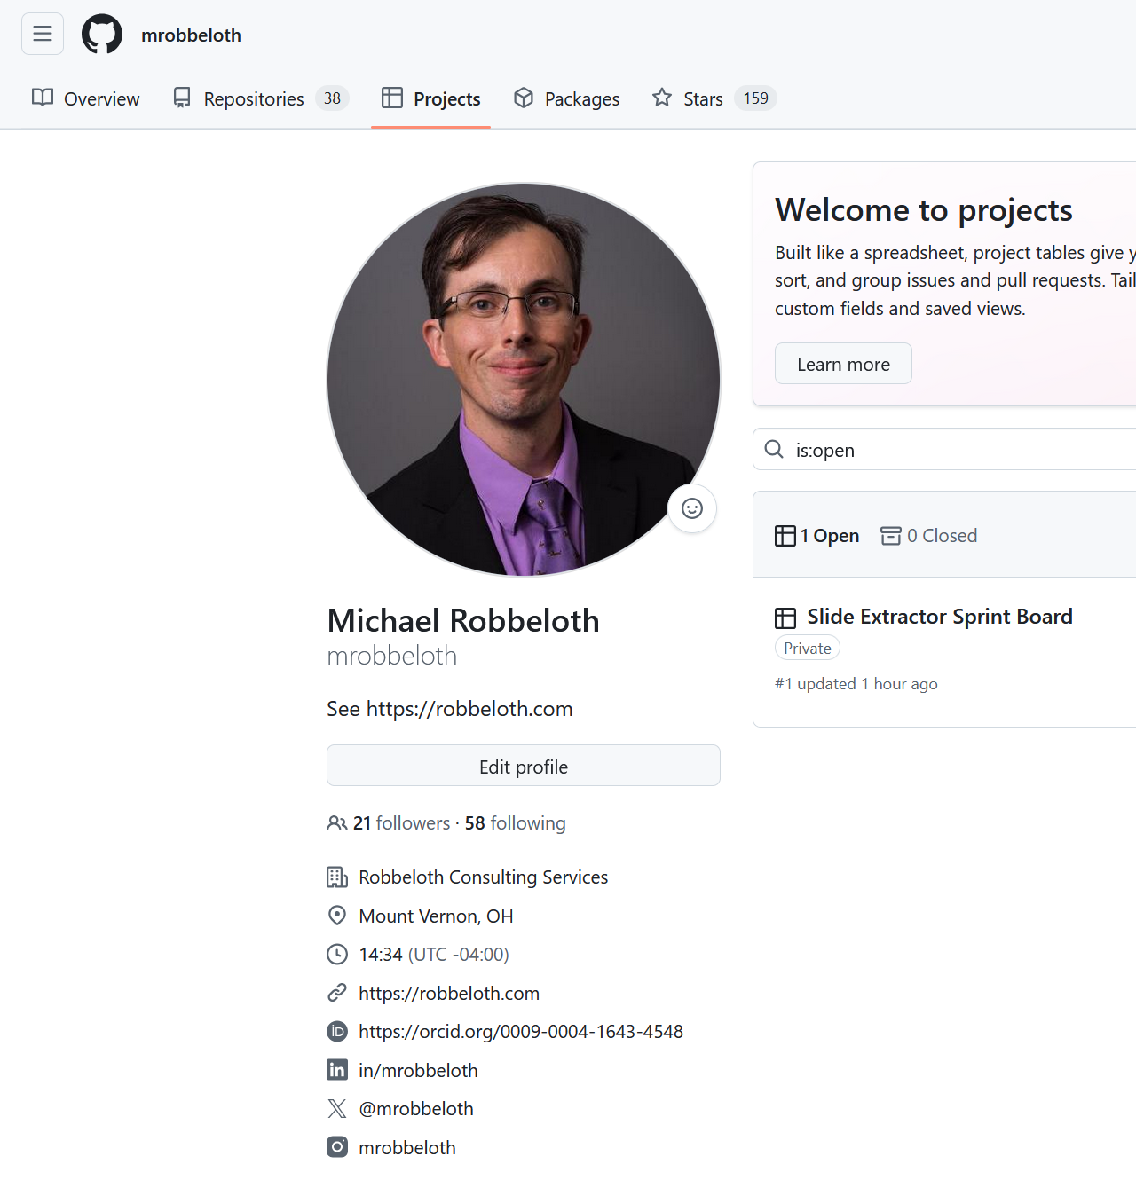
What do we do w/ user requirements? 2/2
Just use the user requirements as is
Add user requirements to a project board with tooling of the development team’s choice
Criticism: ambiguous at this level, especially w/ different stakeholders
Example with GitHub Projects to follow
Could be a whiteboard using writable magnet strips instead, or an enterprise software development tool
Notes:
Recall agile manifesto
We are uncovering better ways of developing software by doing it and helping others to do it. Through this work, we have come to value:
individuals and interactions over processes and tools;
working software over comprehensive documentation;
customer collaboration over contract negotiation;
responding to change over following a plan.
While there is value on the items on the right, we value the items on the left more.
https://github.com/mrobbeloth?tab=projects

Slide 33
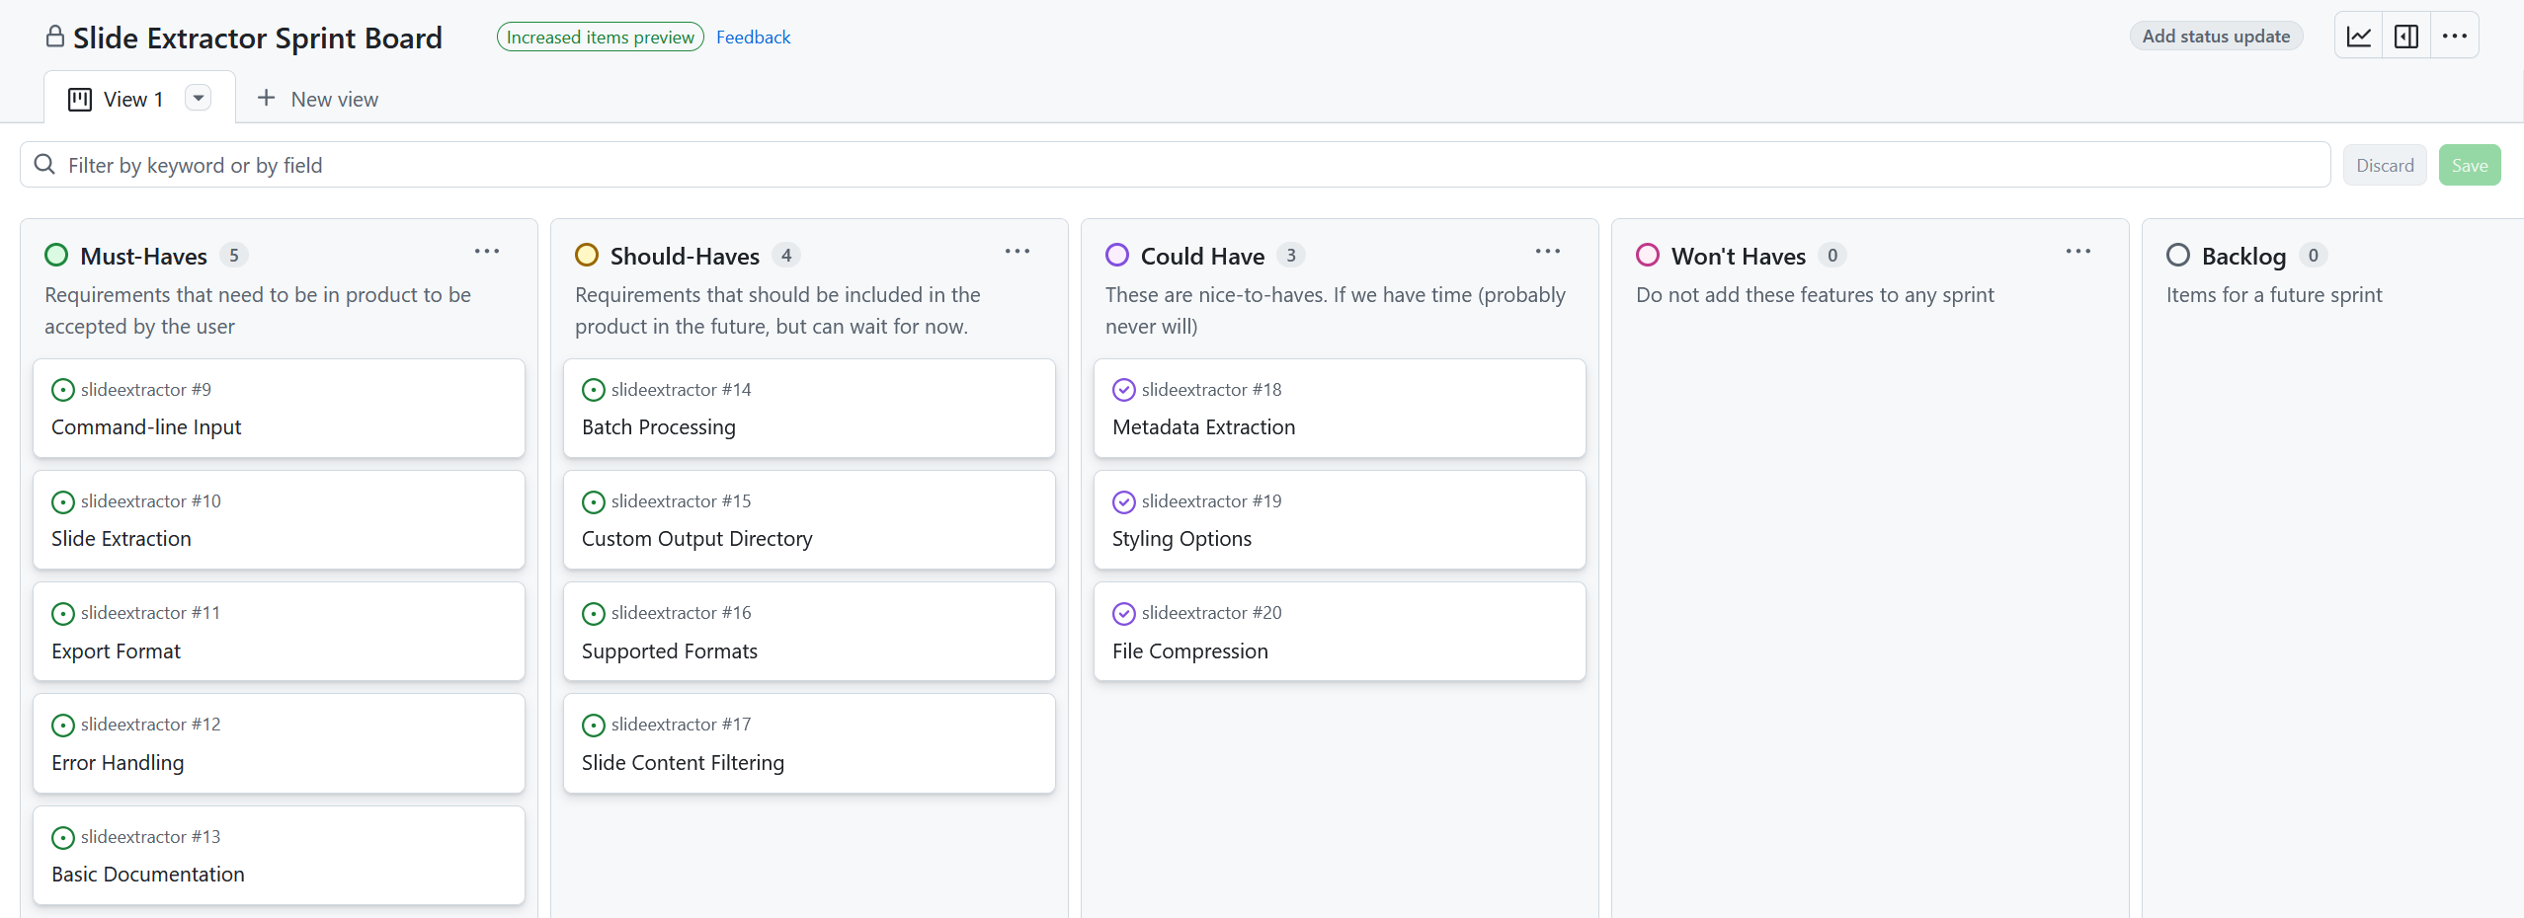
Notes:
Board View
https://github.com/users/mrobbeloth/projects/1/views/1 By tying into the issues system, it allows for verification and traceability.

Slide 34
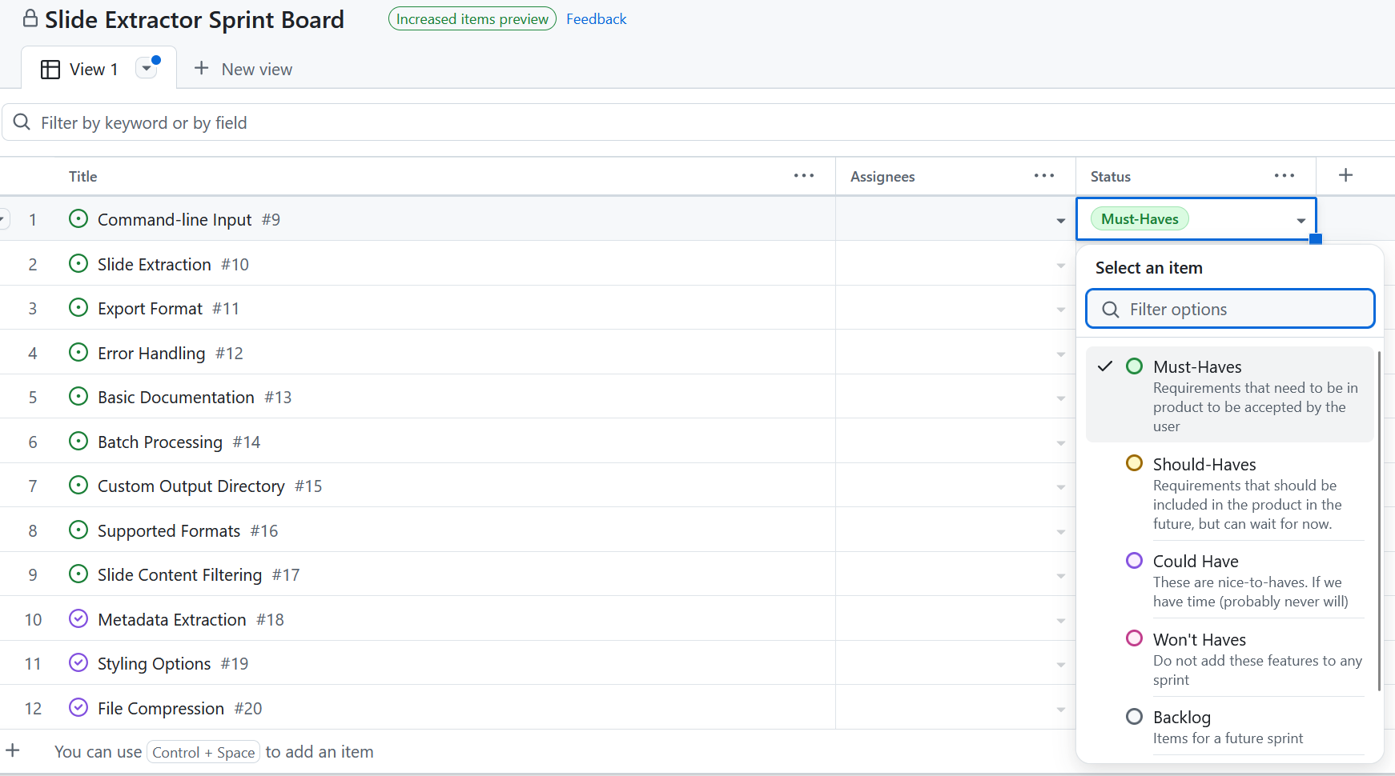
Notes:
Table View
https://github.com/users/mrobbeloth/projects/1/views/1?layout=table

Slide 35

That’s all
What questions do you have for me?

